Slide 1

User Loan Prediction
By Raghad Akram
Data Science bootcamp
SDAIA Academy

Slide 2
Problem
- Getting a loan may take quite a time and take effort of bank employees to make the right decision
- (Thera Bank) whose management wants to explore ways of converting its liability customers to personal loan customers
- The classification goal is to predict the likelihood of a liability customer buying personal loans
1

Slide 3
Data
The data contains more than 5000 rows and 14 attributes specific to the customer’s personal data, this data is processed by Preprocessing operations
Attribute | Description
ID | User’s id
Age | User’s age
Experience | Life experience
Income | User’s income
ZIP Code | Telephone number
Family | Number of family members
CCAvg | The arithmetic average of the credit card
Education | User education level
Mortgage | Kind of foreign payment
PersonalLoan | Does the user have a personal loan?
SecuritiesAccount | User’s securities account
CD Account | Certificate of deposit
Online | Is the user account active?
CreditCard | Does the user have a credit card?
2

Slide 4
01
04
02
05
03
Algorithms
EDA
Evaluation
Exploratory Data Analysis
Comparison of different Models
Prepare
Selection
Preparing the data to train a model
find that the Naive Bayes is the best algorithm.
Models
Training and making predictions using a 3 classification models (Knn, Naive Bayes and Kmeans)
3

Slide 5
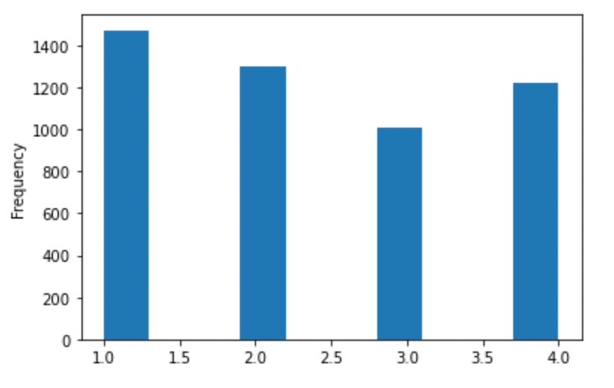
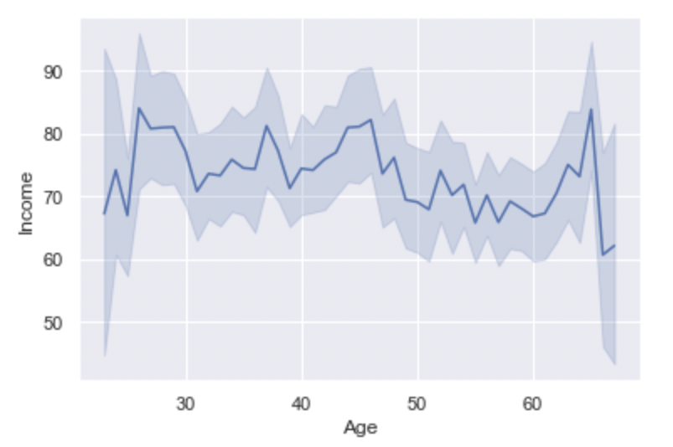
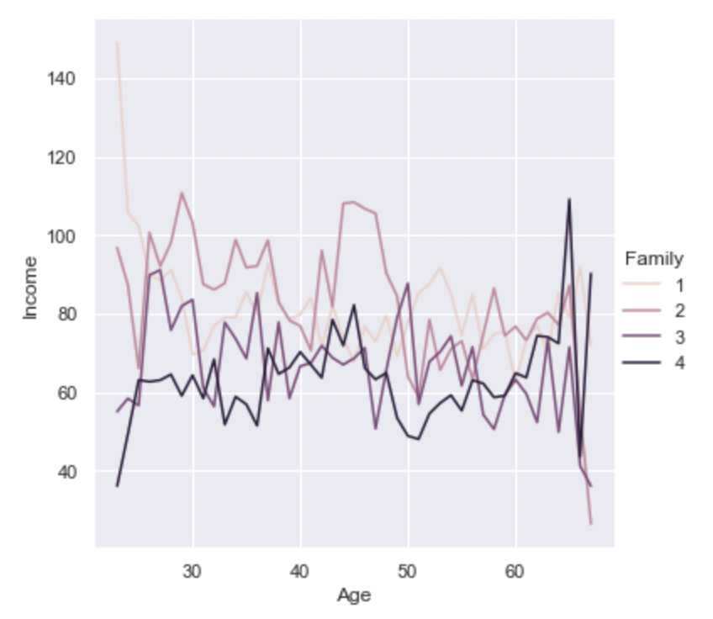
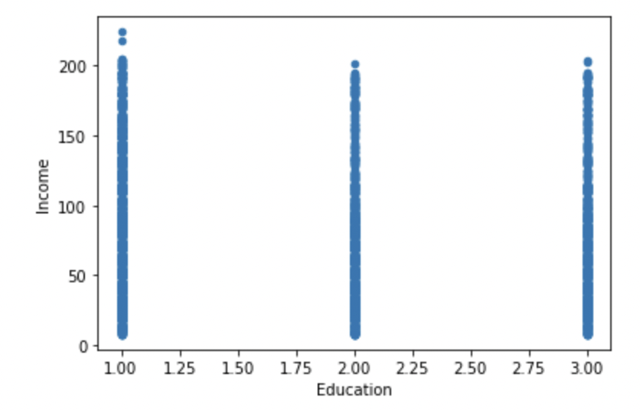
Plot how many family members for borrower
Line plot for Age and Income features
Relplot for for Age, Income and Family size Features
Scatter plot for Education and Income features
4

Slide 6
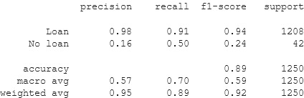
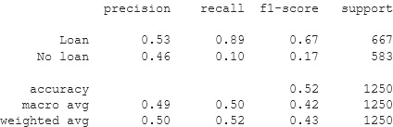
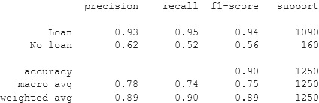
Results
Knn model results :
Kmeans model results:
Naive Bayes model results:
5

Slide 7
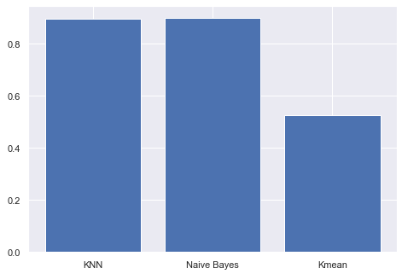
The Naive Bayes is the best algorithm.
WHAT IS THE FINAL RESULT?
6

Slide 8
Tools
Python
Jupyter Notebook
High-level Software language
Open-source web application
Sklearn
Pandas
Software library for modeling.
Software library data manipulation.
Matplotlib & Seaborn
Software library for plotting
7

Slide 9

THANKS!
8

